Slide 1
Network Diagram

Slide 2
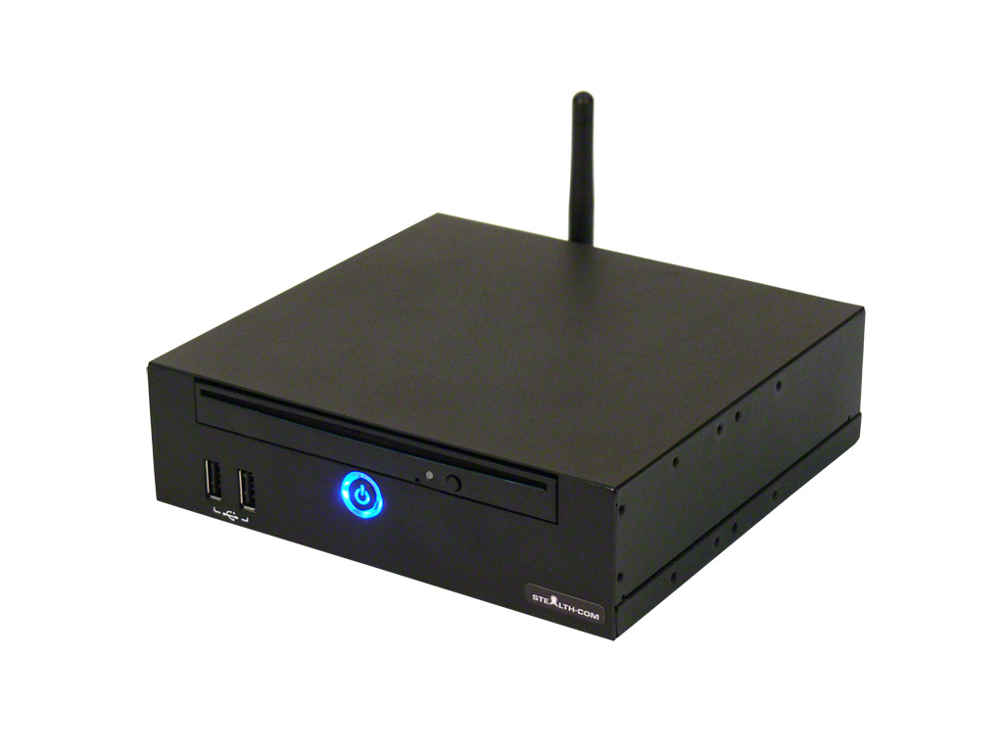
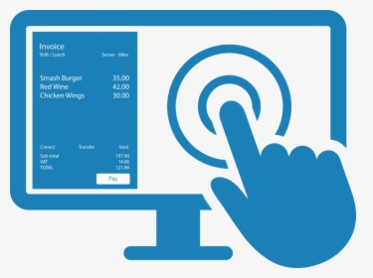

Ticket Station
Server
Windows
192.168.0.10
192.168.0.11
192.168.0.12
Exit 1
Entry 1
192.168.0.23
192.168.0.20
192.168.0.24
192.168.0.21
Exit 2
Enrty 2
Windows – Remote Desktop Application
RPi – VNC, Putty

